Slide 1
ScotTrip - A Touch of the Exotic...
By Team Ping Poke

Slide 2
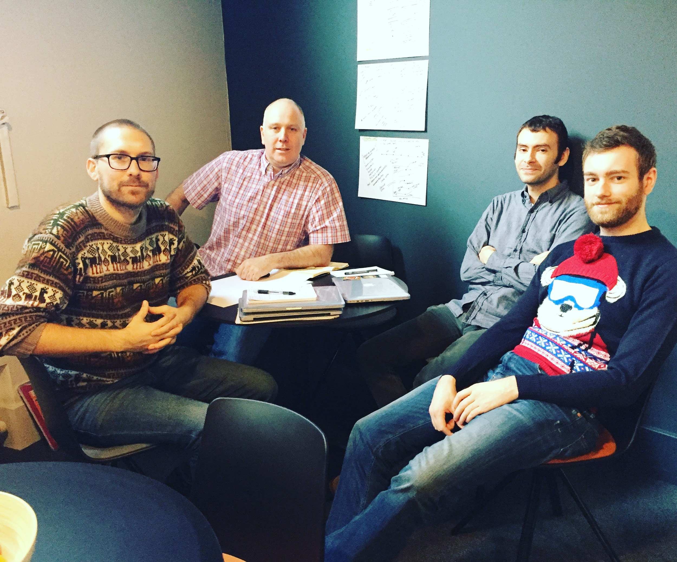
Introducing the team
Max - Philosopher
Ross - Mr T
Tom - The Face
Adrian - Photographs

Slide 3
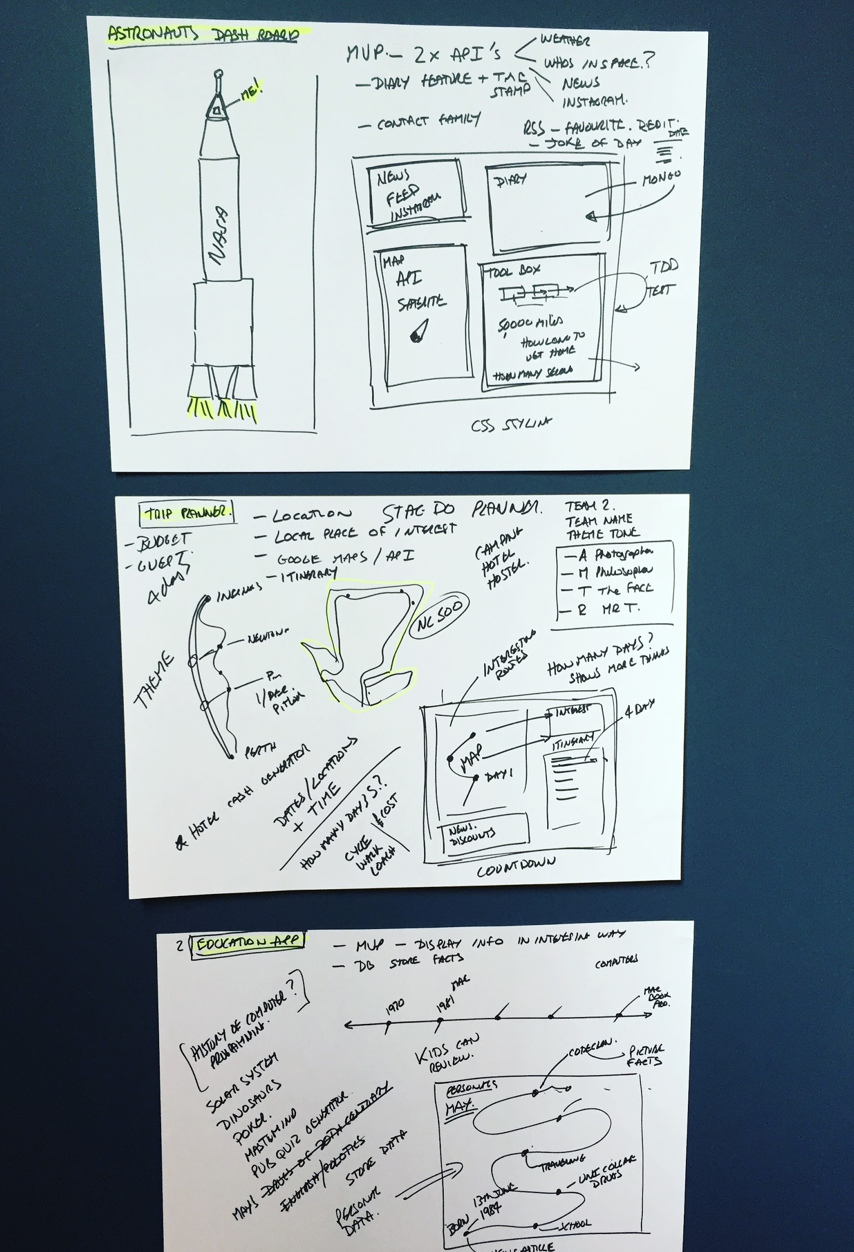
Brain Storming
Initial brainstorming narrowed the brief down to 3 contenders
Space Dashboard
Trip Planner
Education app
Story boards for each was created

Slide 4
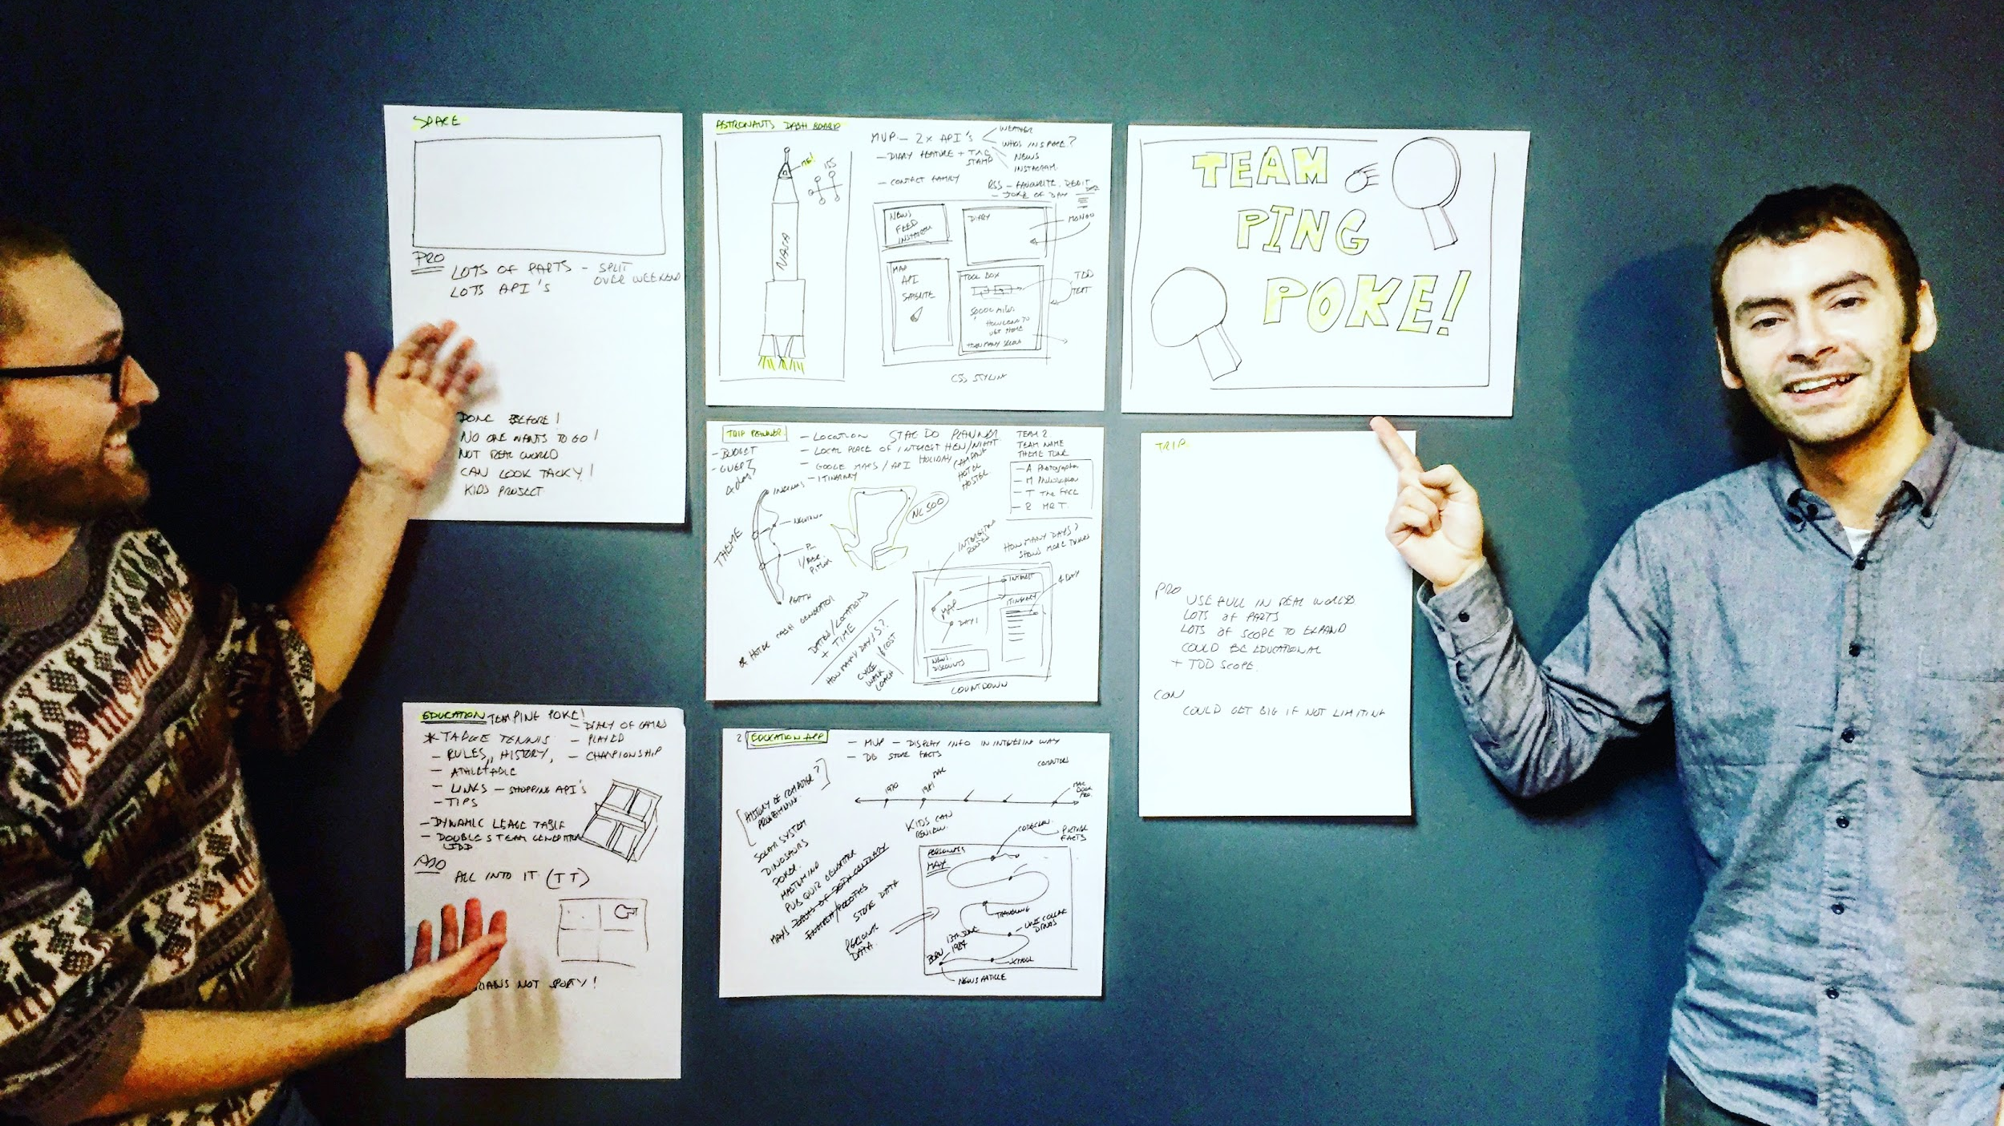
Trip Planner
Wins! (despite Alan’s encouragement on a ping pong themed app)

Slide 5
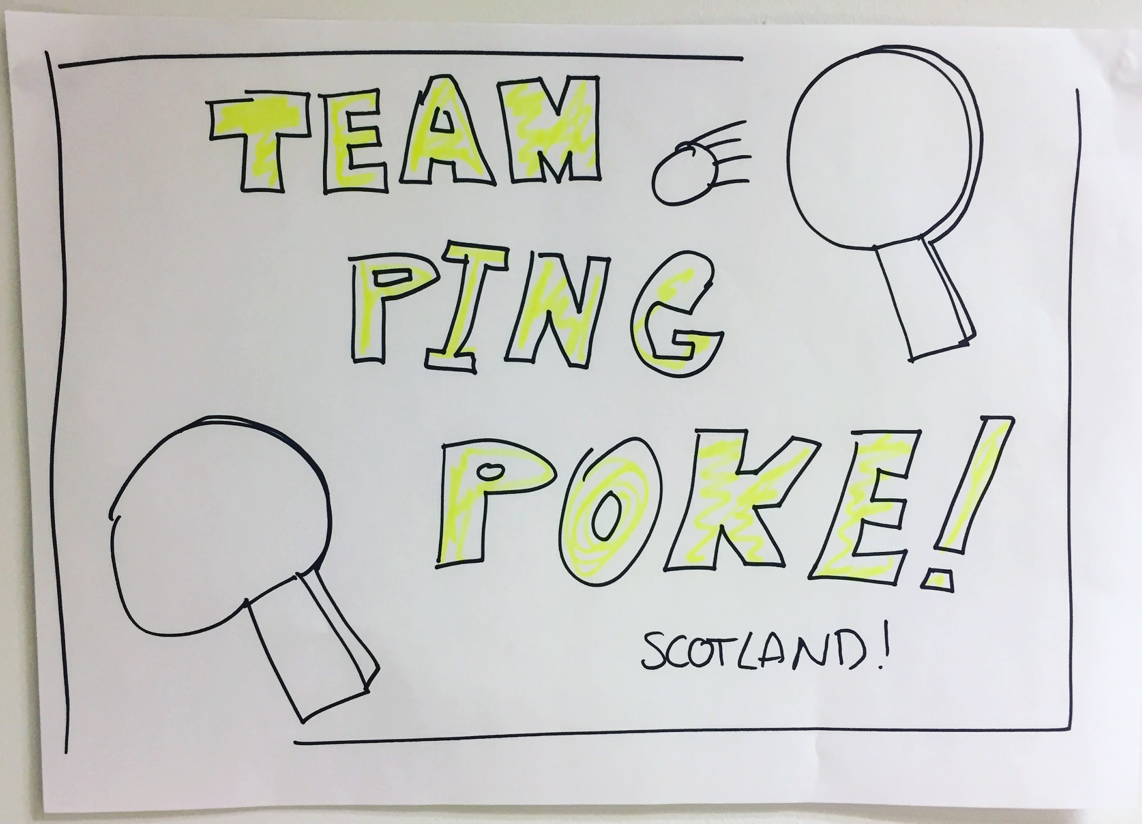
We needed a team Name and Logo...

Slide 6
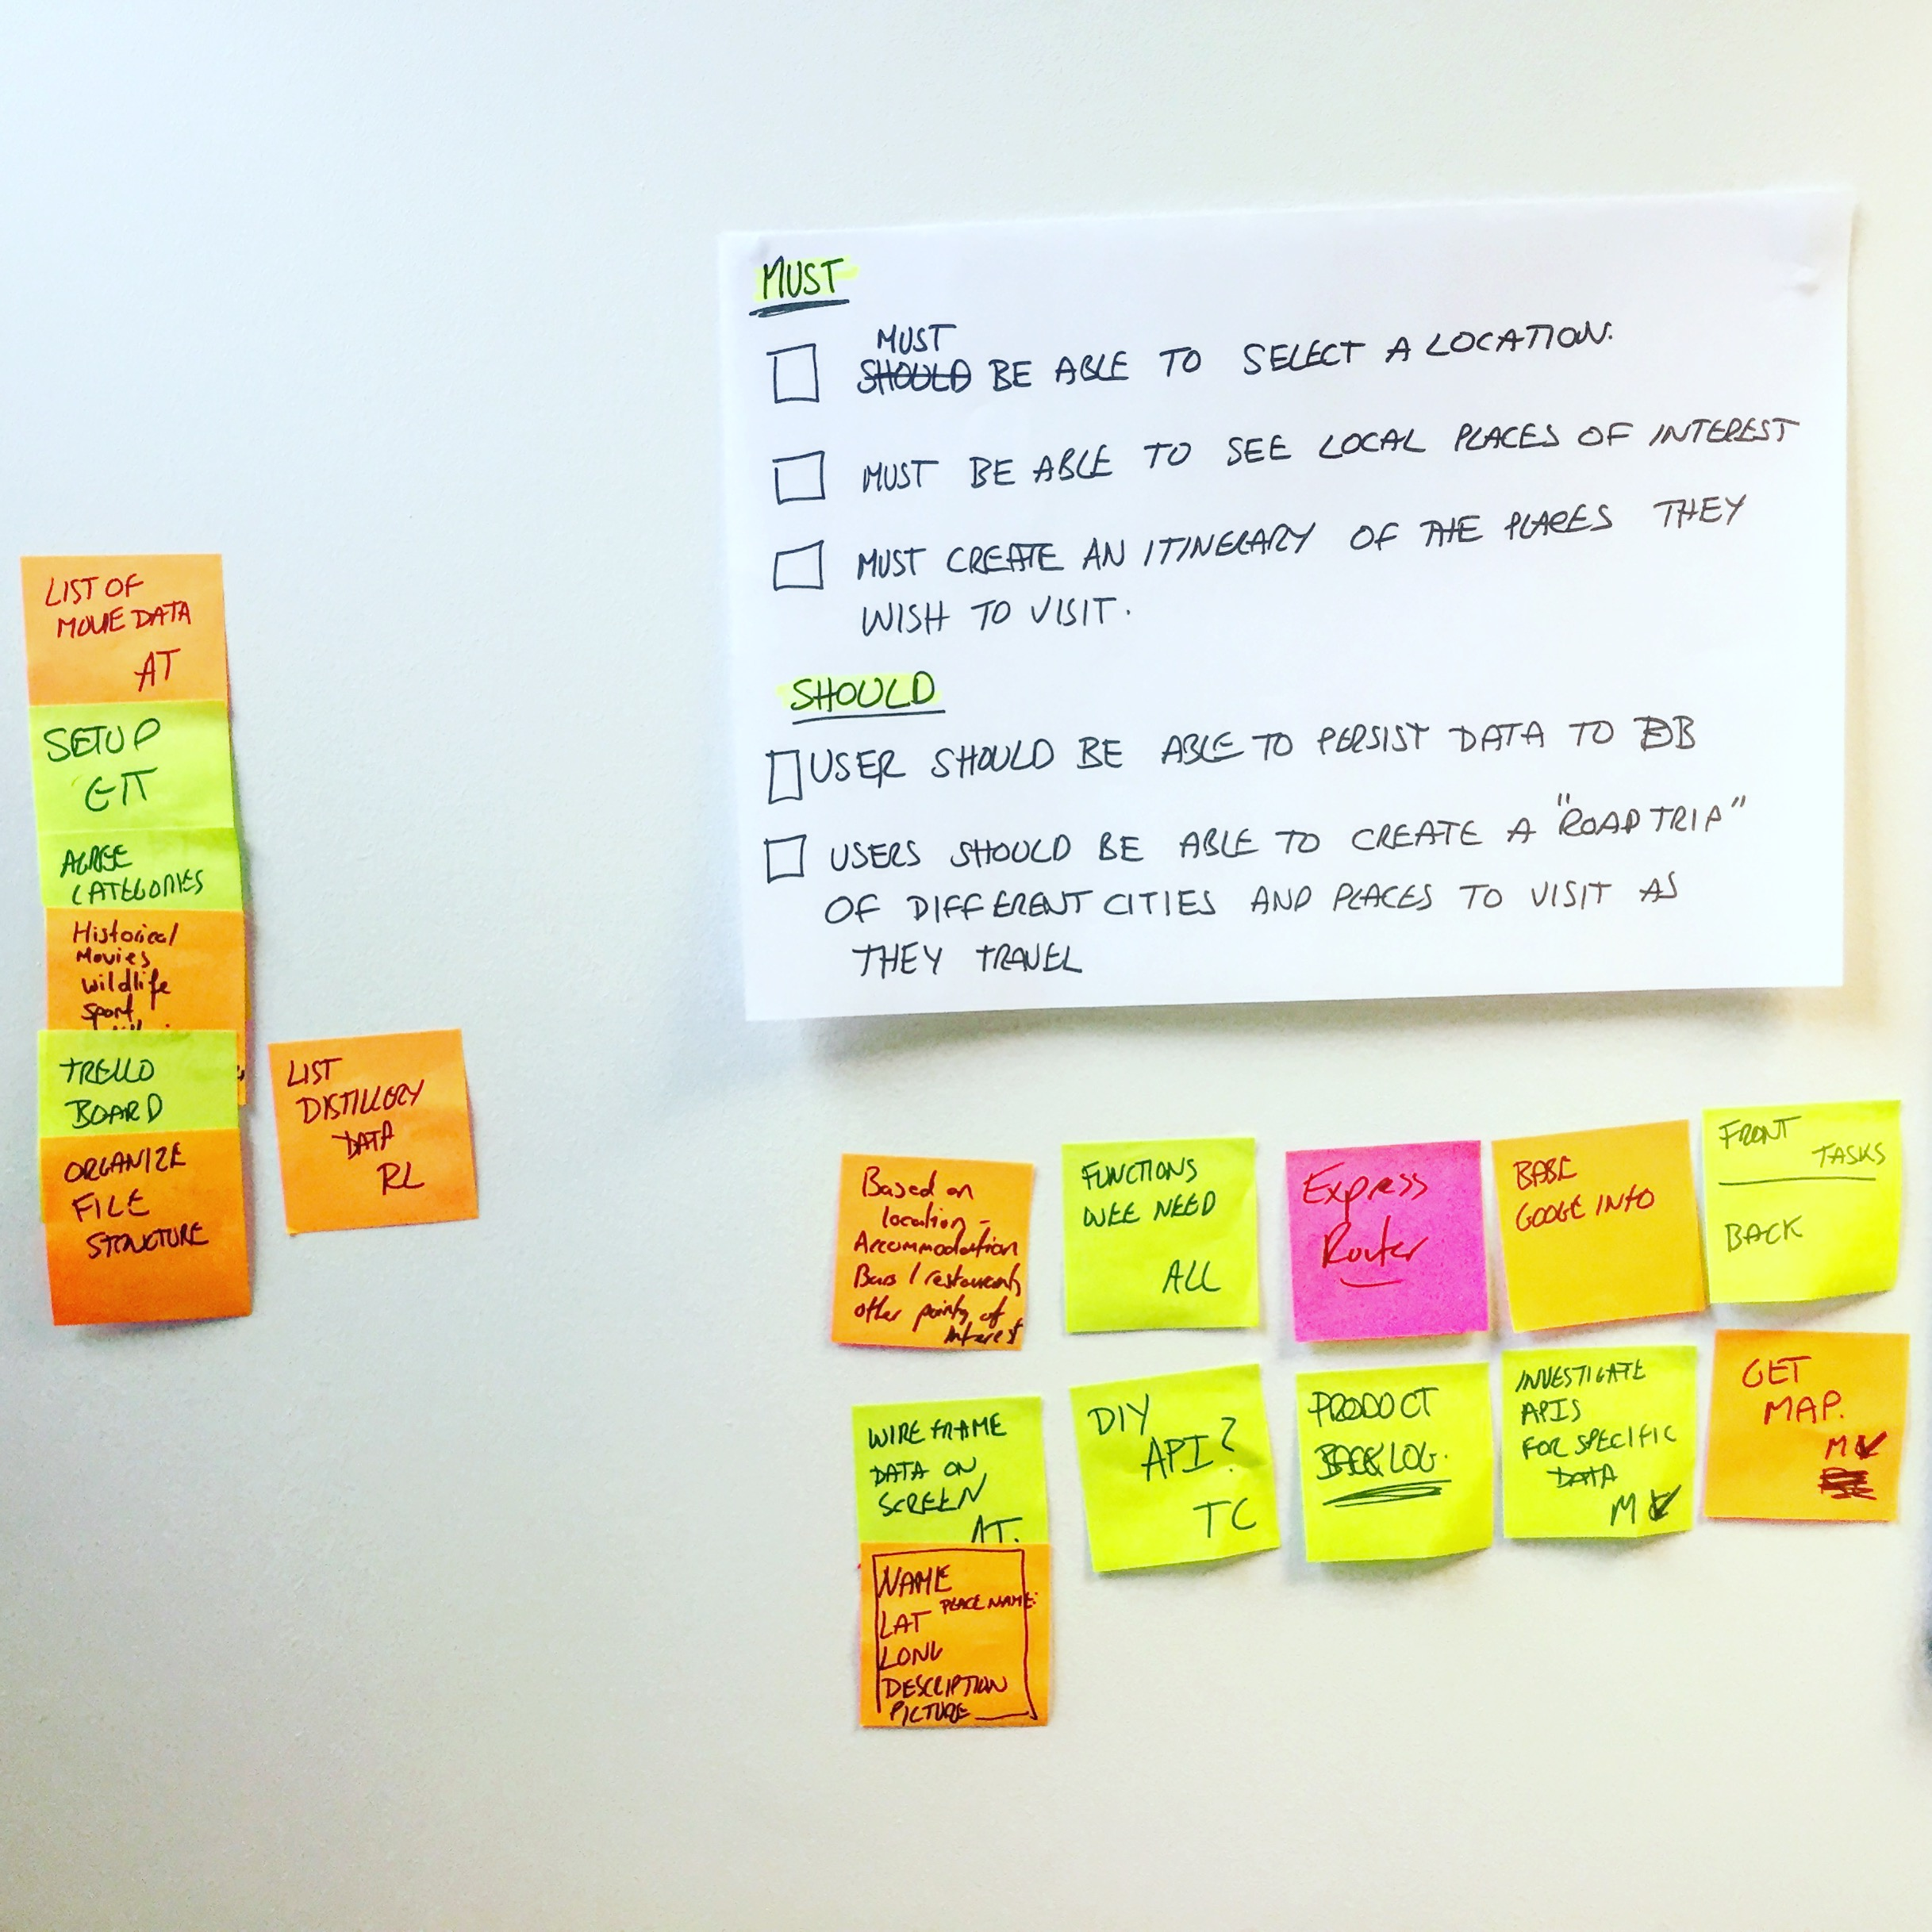
Minimal Viable Product
Must:
Be able to Select Location
Be able to see Local Places
Create an Itinerary of the places they wish to visit
Should:
Be able to persist data to DB
Be able to create a “Road Trip”

Slide 7
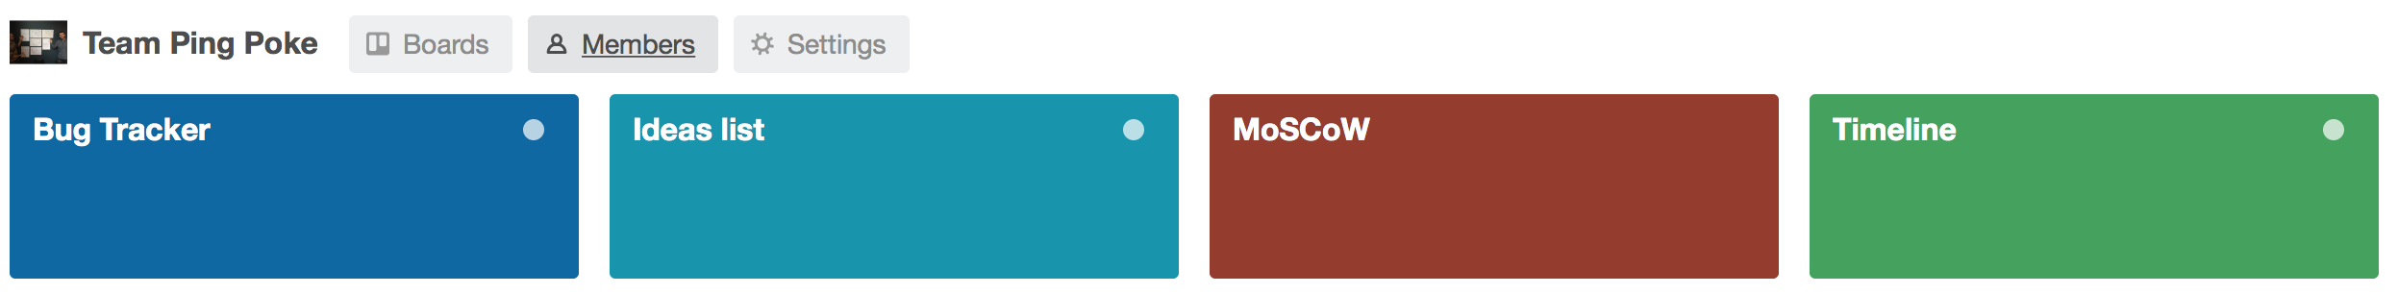
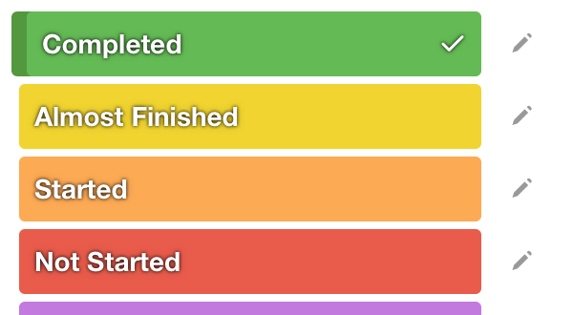
Trello
Created a Trello organisation with 4 boards
MoSCow - (Must Should Could and Would)
TimeLine - Plan of tasks and when they would be actioned
Bug Tracker
Ideas List
Assigned members of the team to the organisation
Used colour labels to track status of tasks

Slide 8
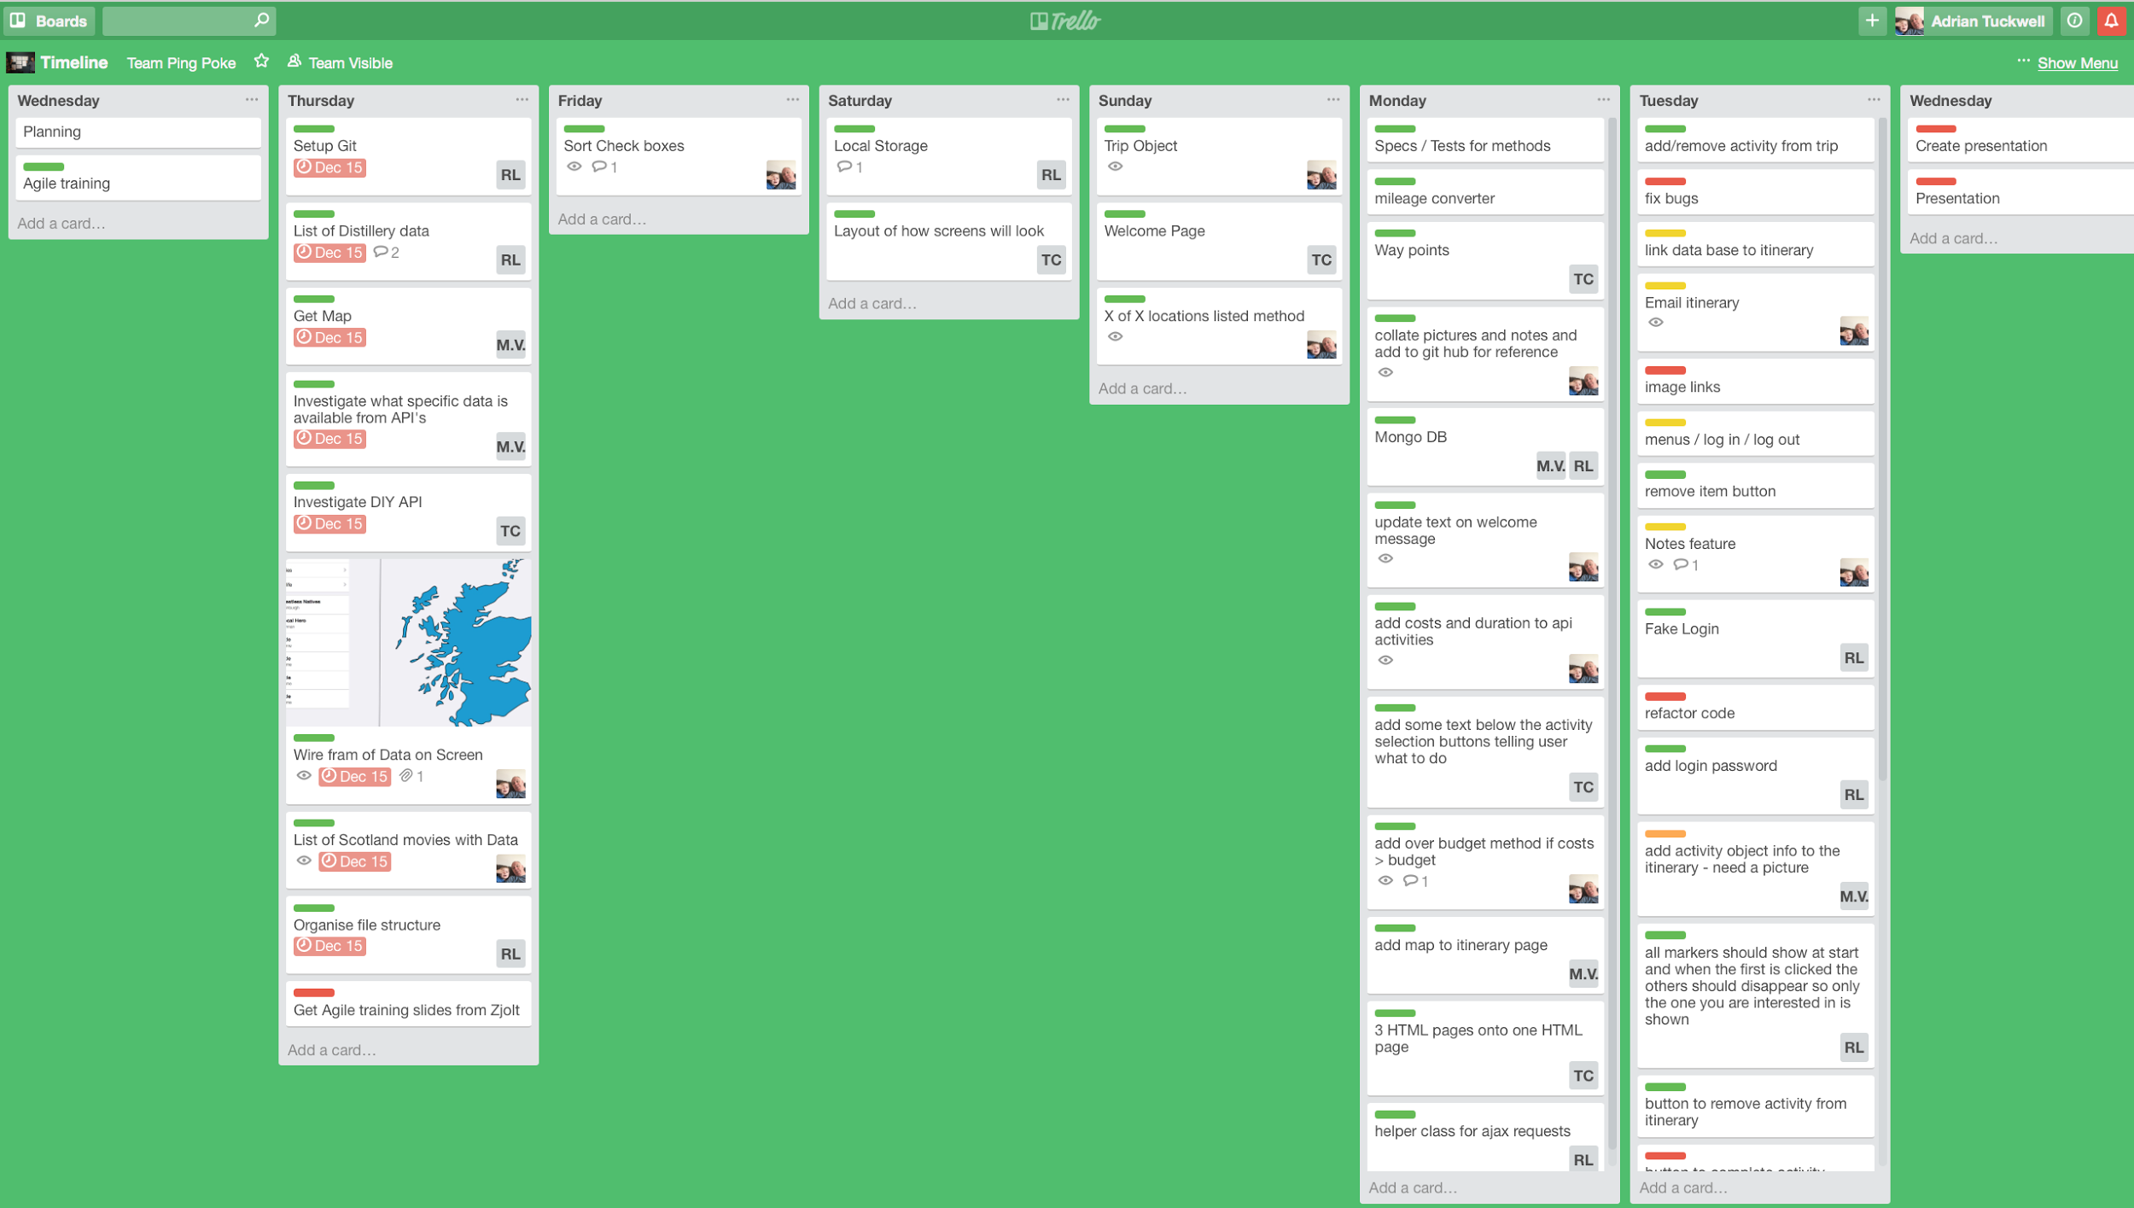
Trello Timeline
Reviewed mornings and during day.
Tasks labels updated
Tasks moved to right till complete

Slide 9
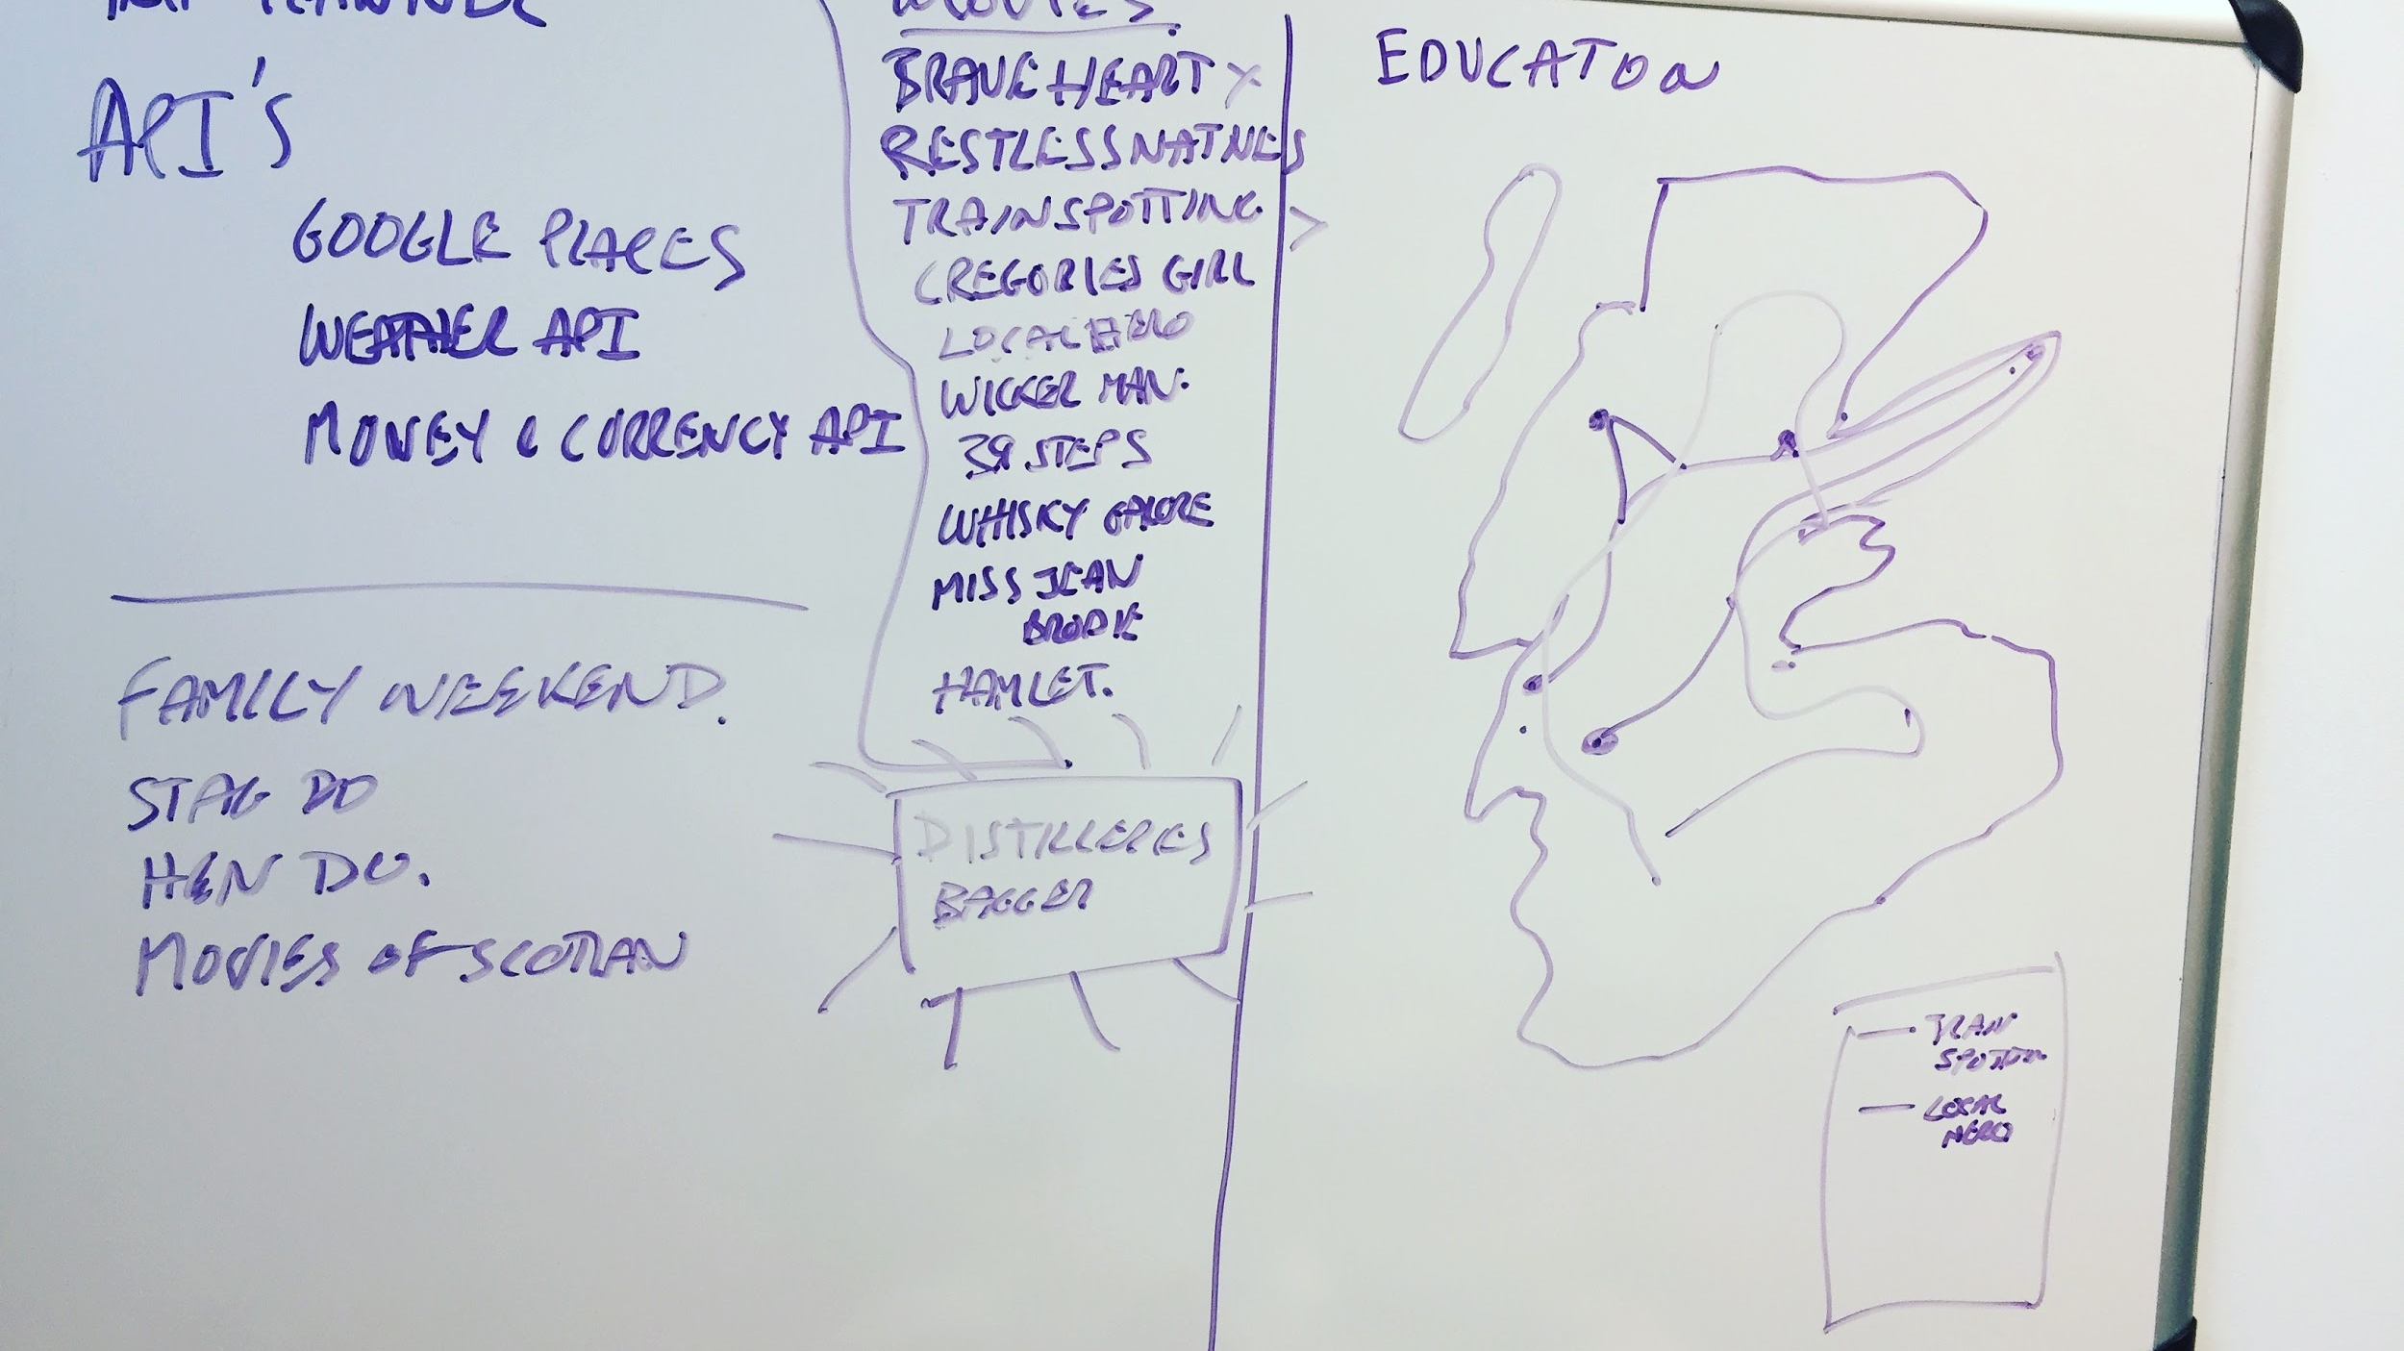
Many Whiteboard Sketches were created
(This is the initial Sketch for a Trip Planner)

Slide 10
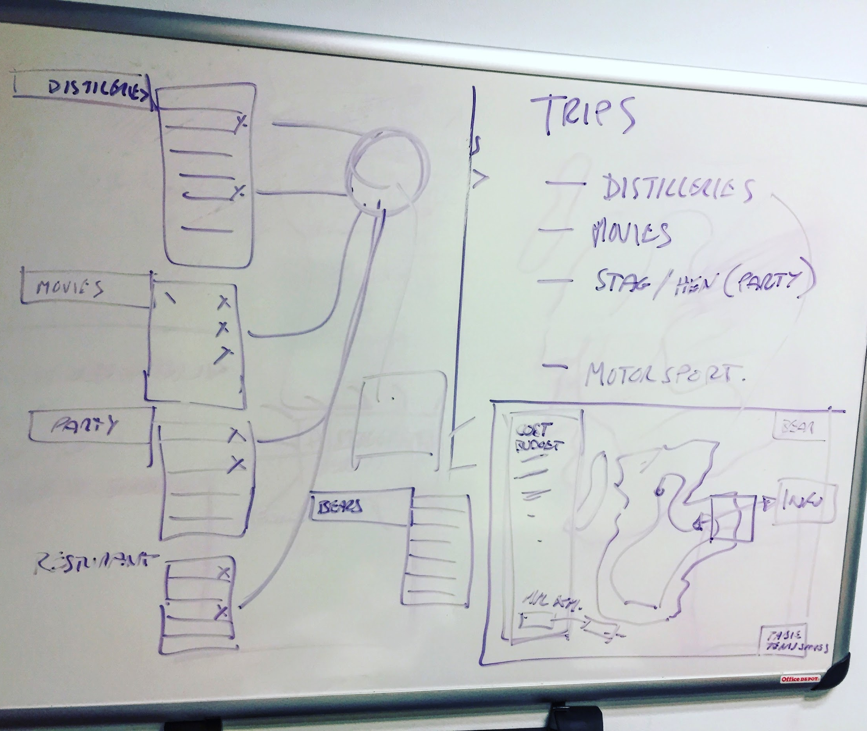
We started breaking the ideas into Objects...

Slide 11
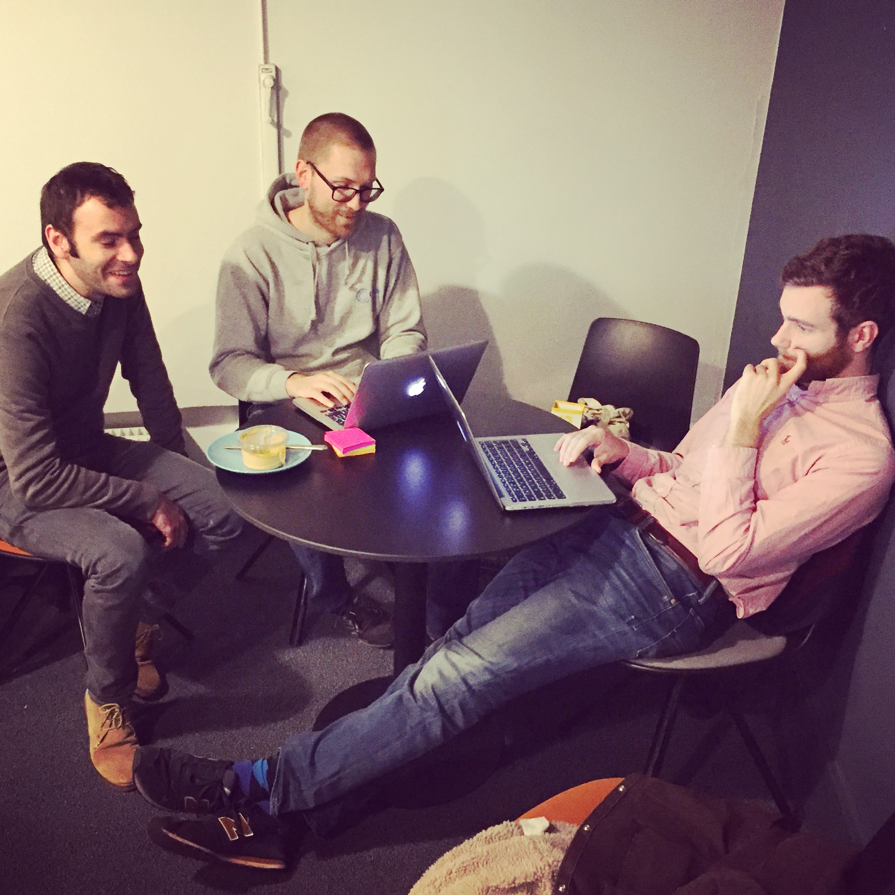
Programmed as TEam on Thursday to get basic APP together

Slide 12
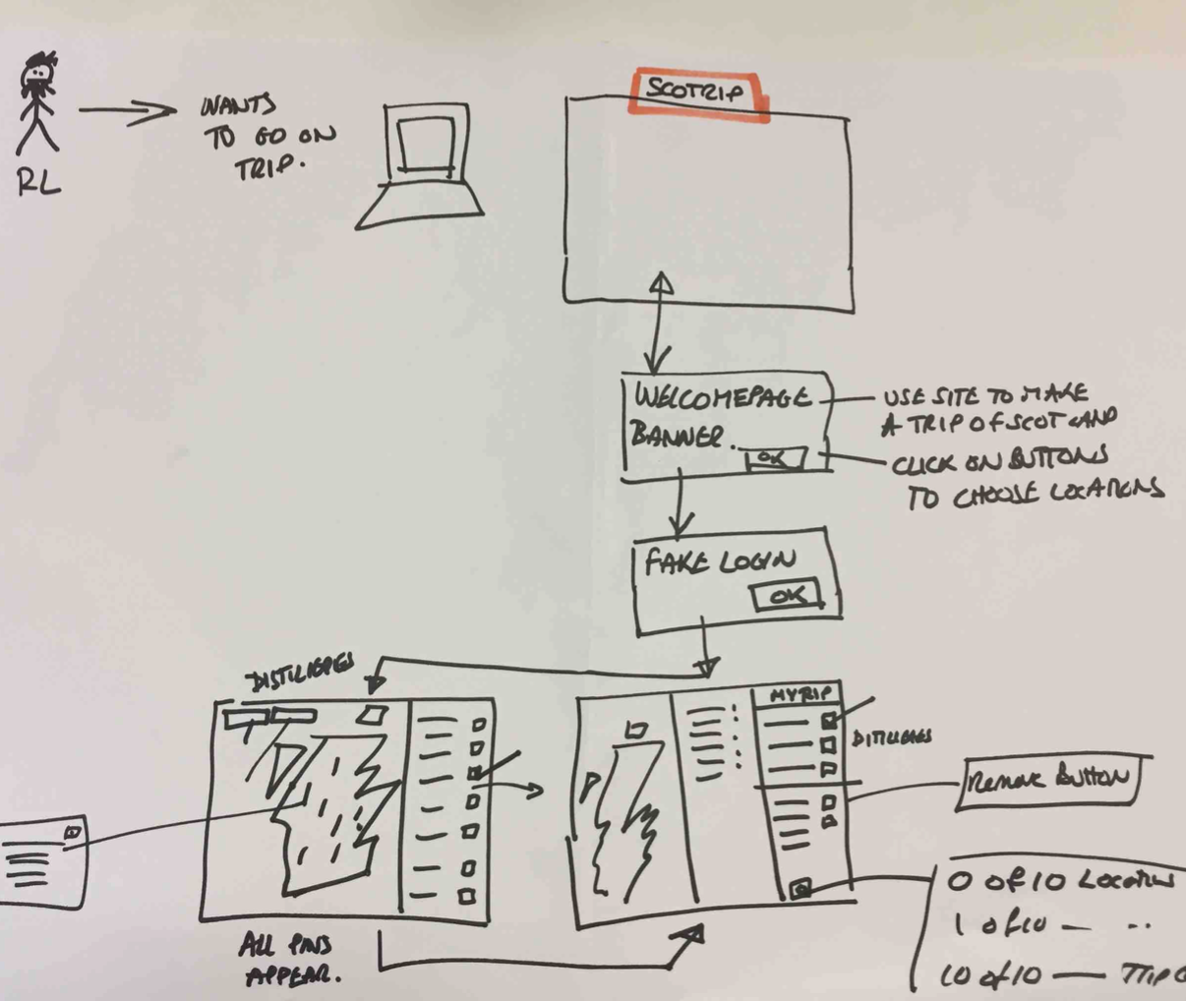
With the basics working
we did a Use CASE walk through

Slide 13
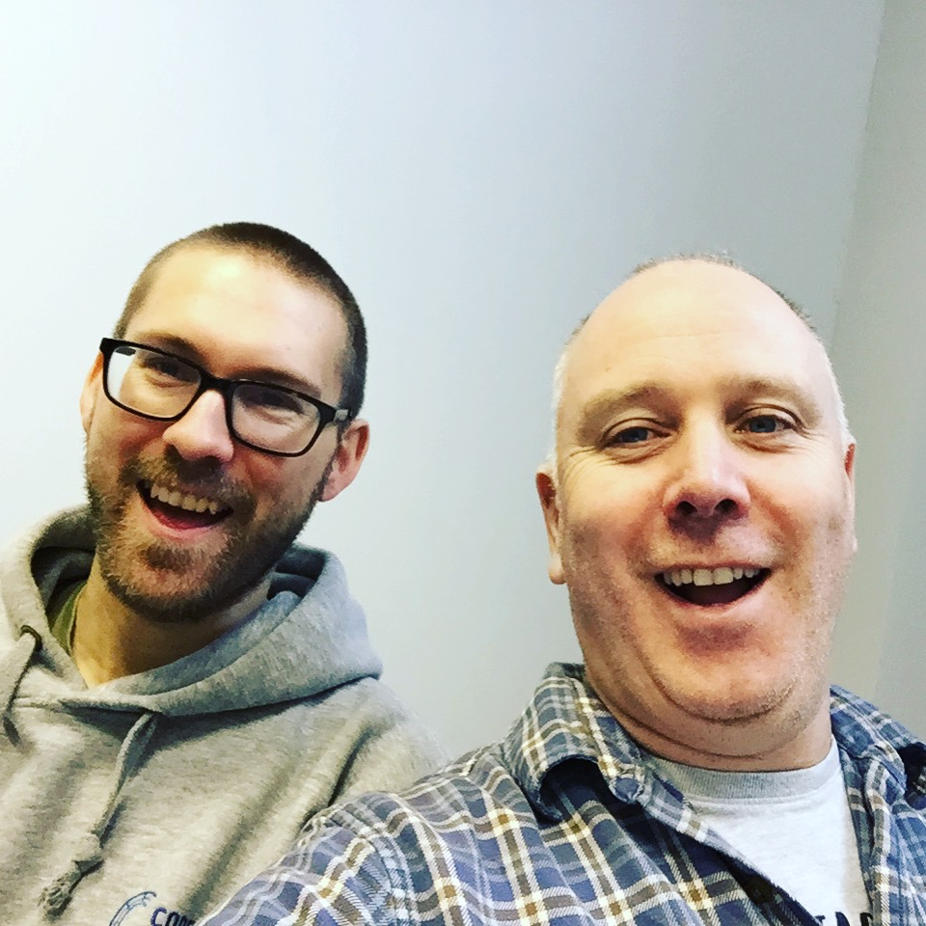
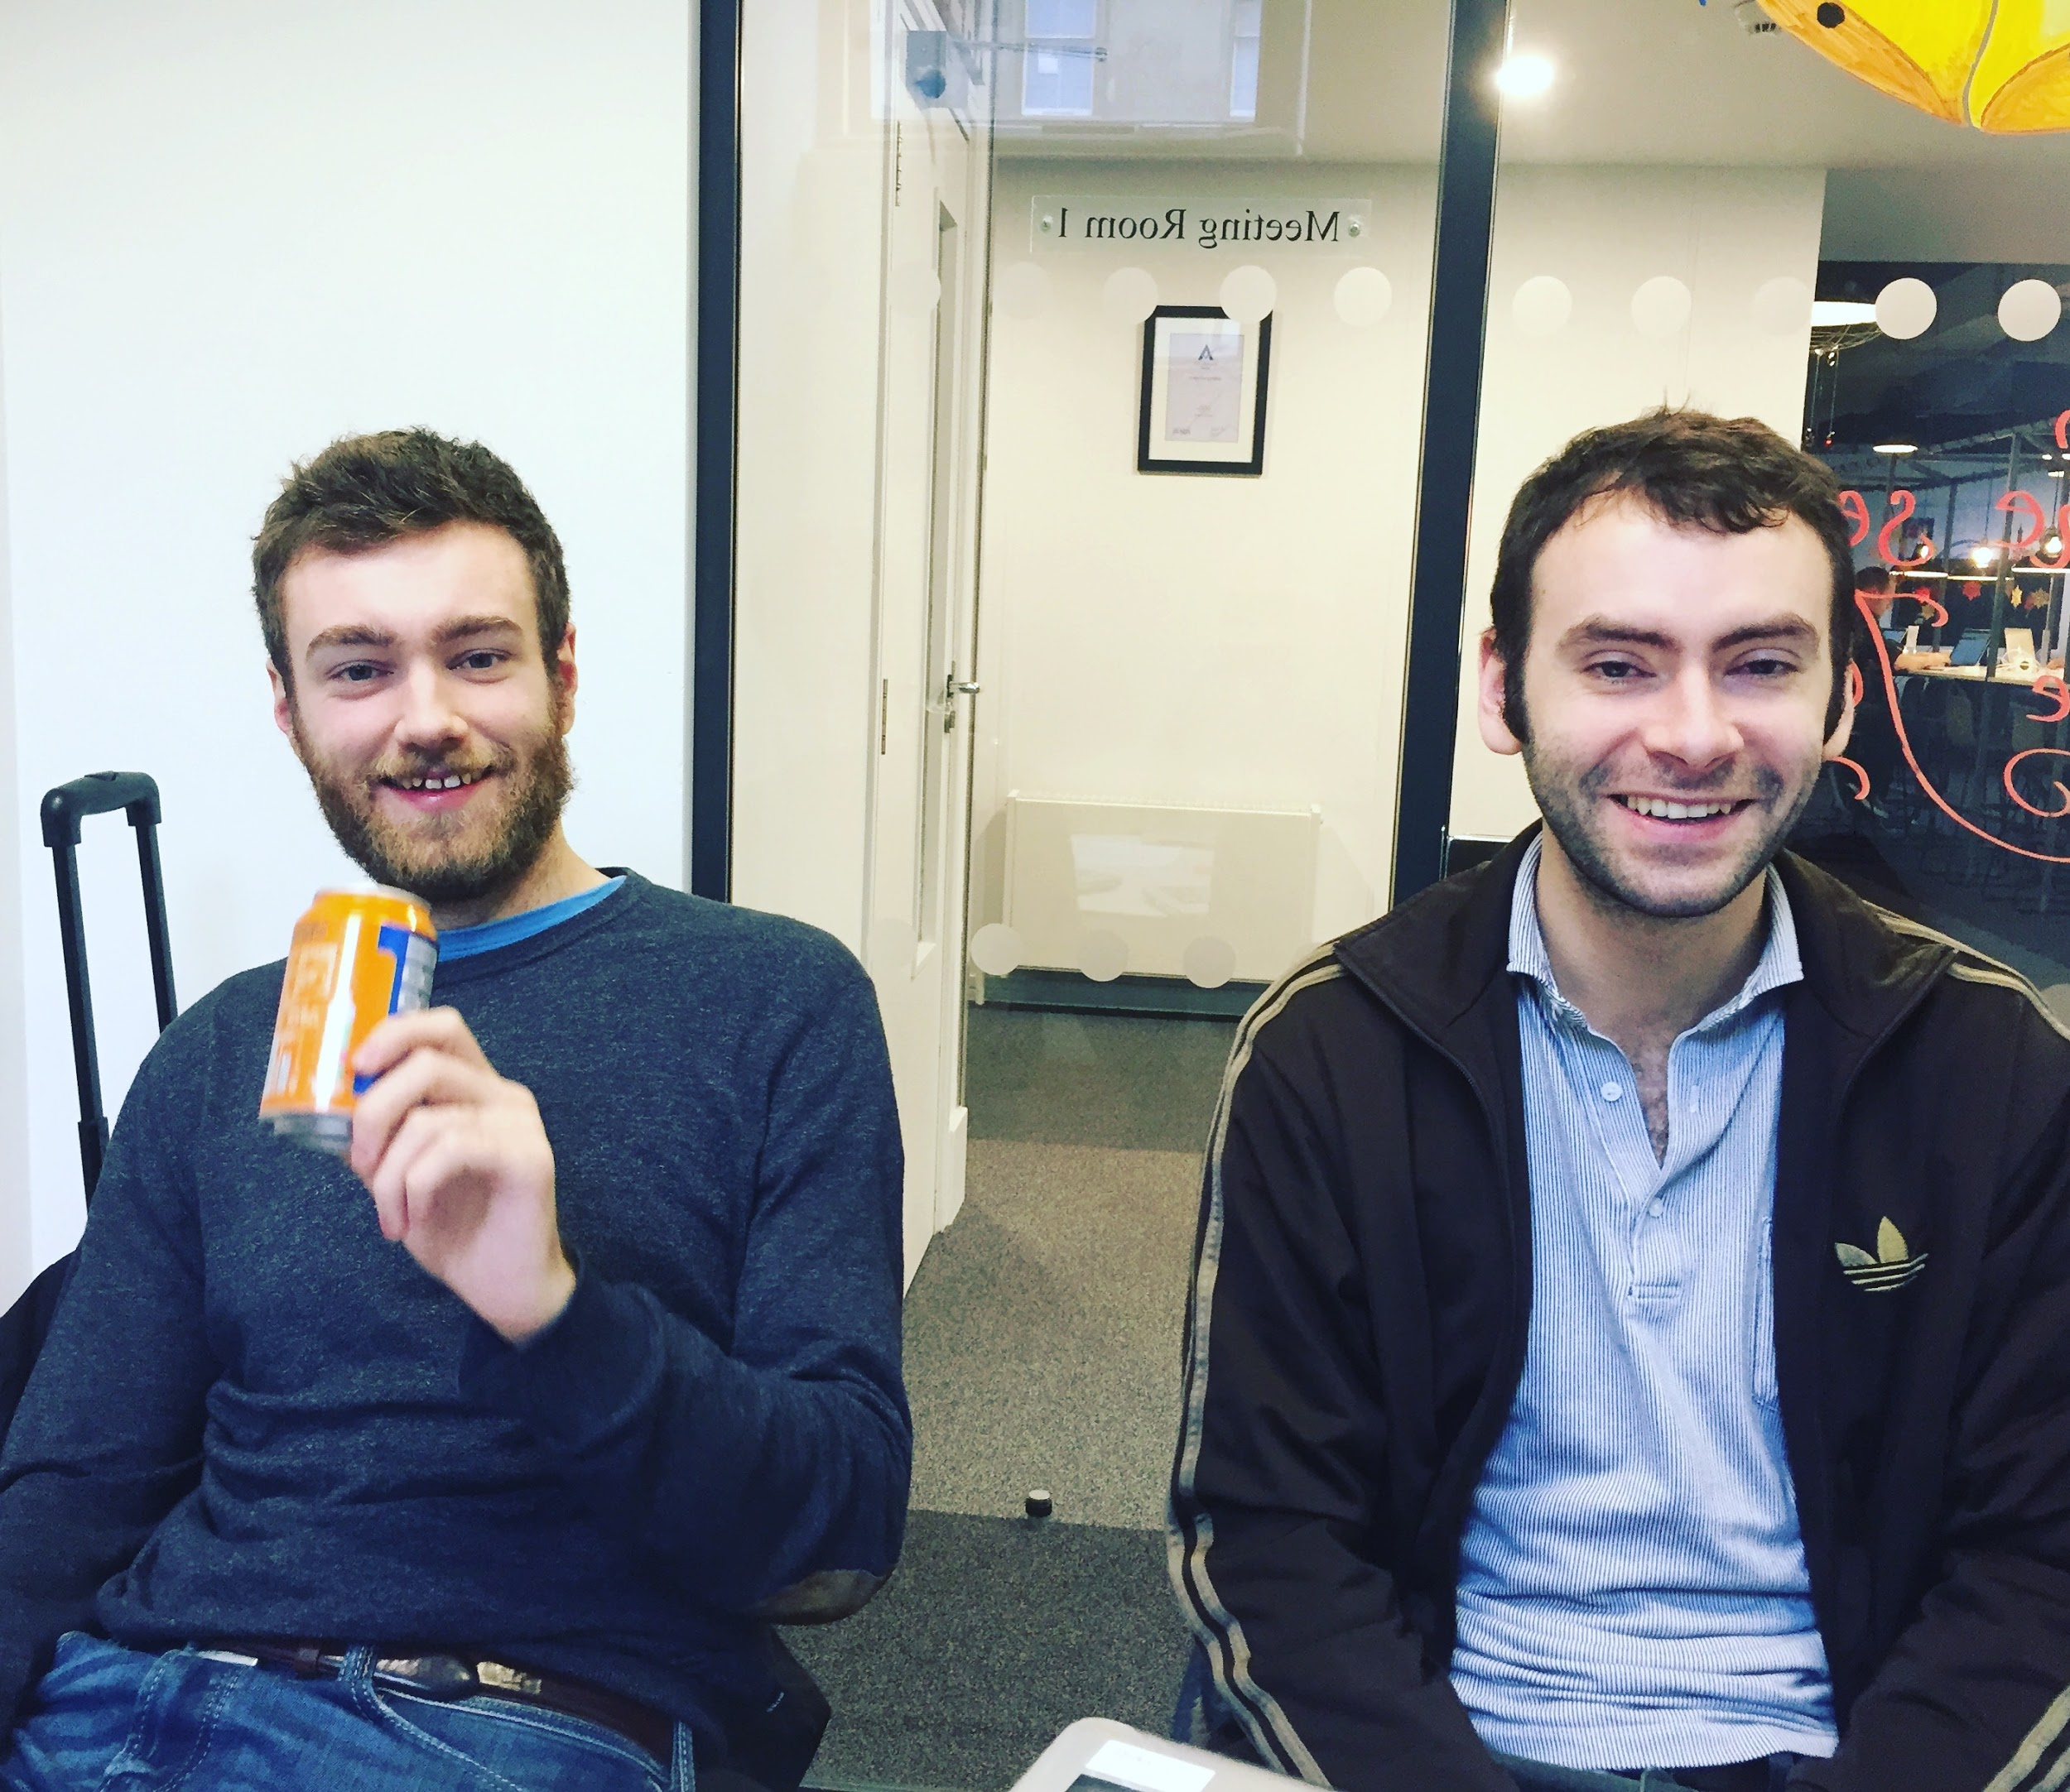
Friday and we split into Two pairs...
No Hangovers
Hangovers

Slide 14
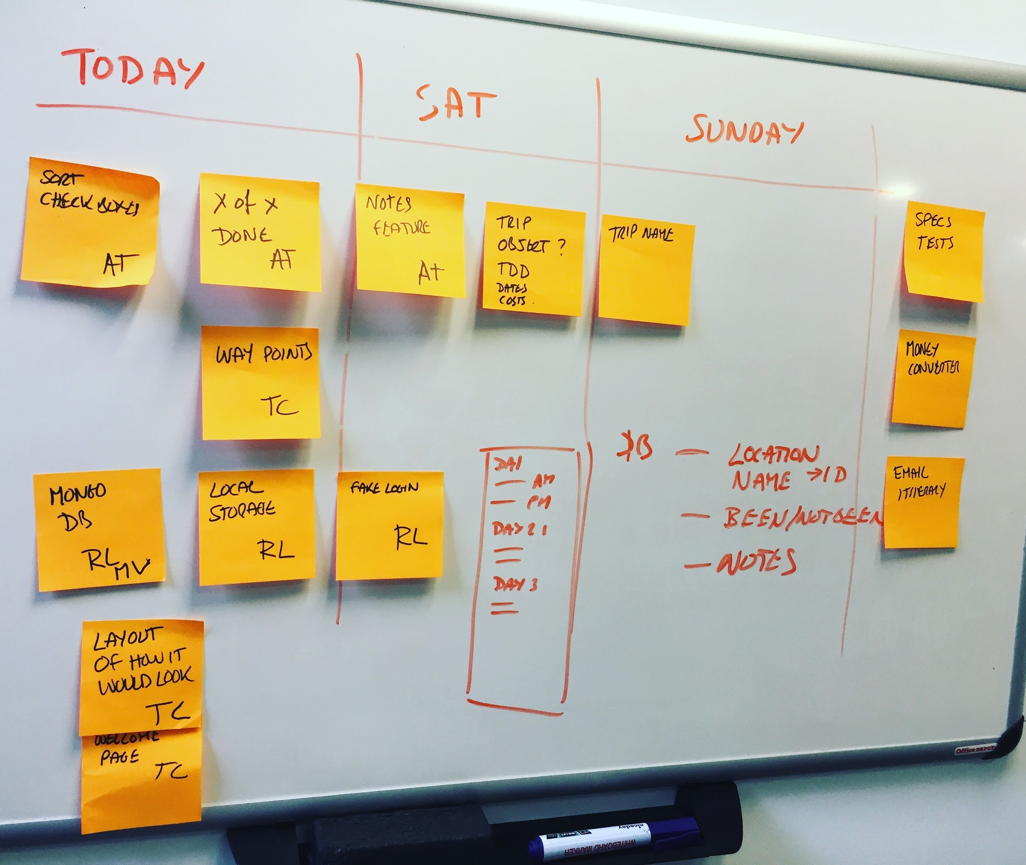
Weekend PLan of Tasks to reduce impact of down time...

Slide 15
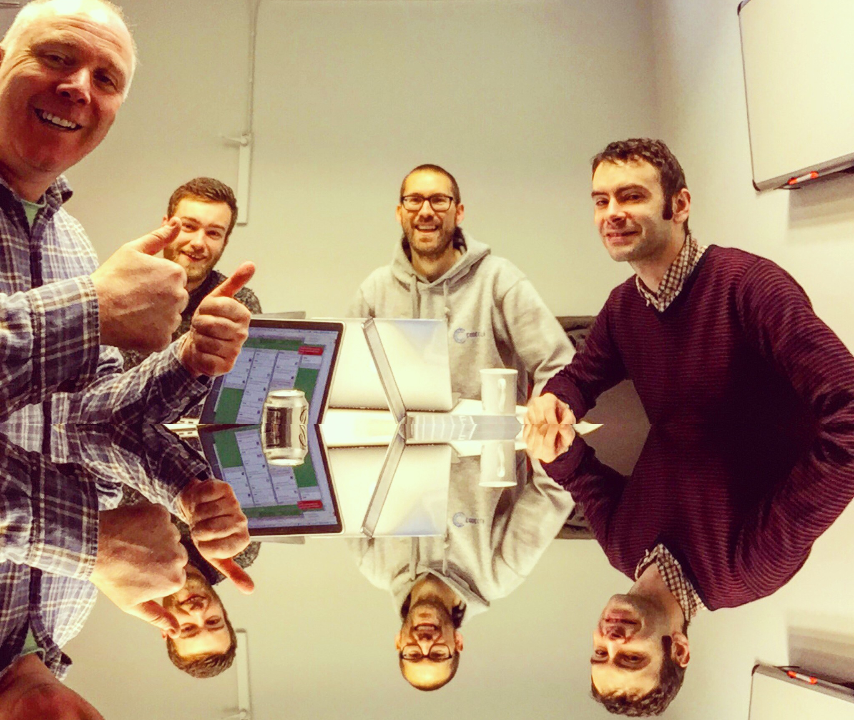
MVP Met!

Slide 16
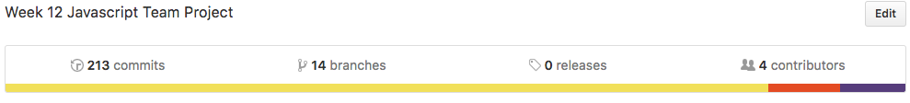
Project KPI’s
213 Commits (and counting)
14 Branches
27 tests passing
0 lost time incidents (despite Cyrus Virus)

Slide 17
DRUM ROLL… and APPLAUSE

Slide 18
SCOT TRIP
THE APP

Slide 19
Another round of Applause !
And off into the code!

Slide 20
Front End
What we did…
Made the CSS early on
One page app
Map fun
Interesting features

Slide 21
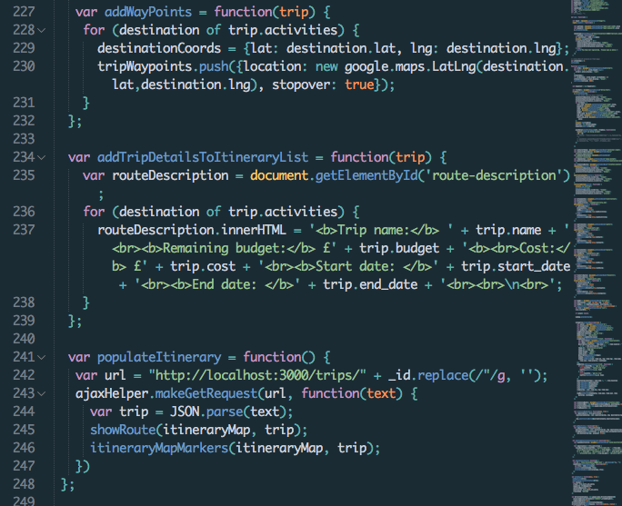
Add Waypoints...

Slide 22
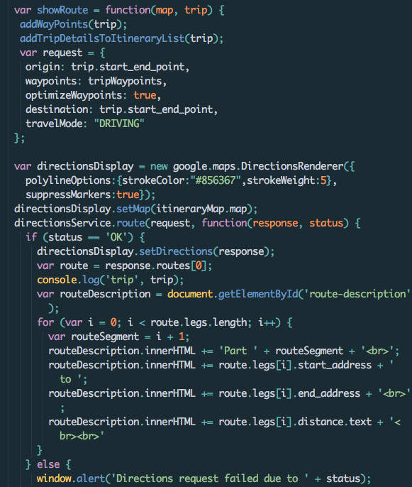
Directions...

Slide 23
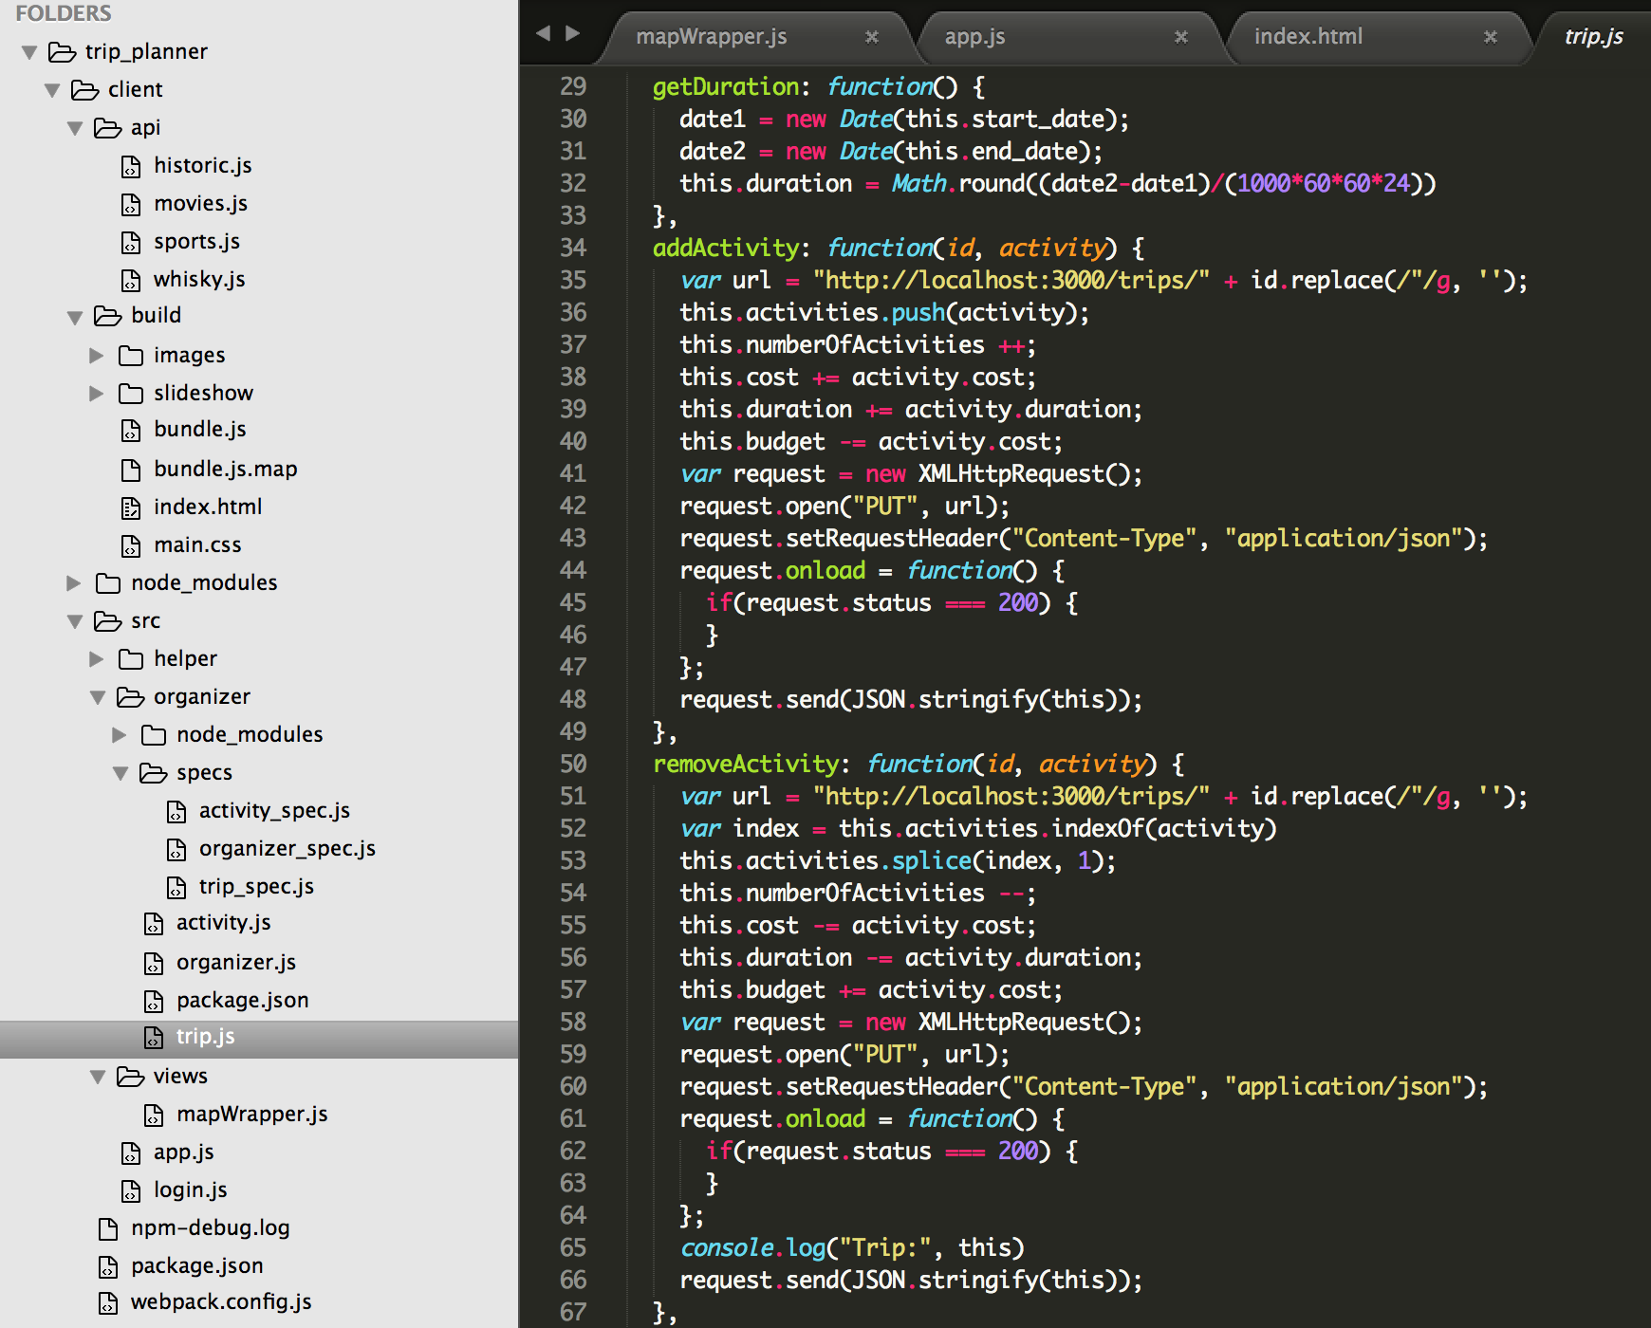
BackEnd
Interesting features
Map & MapWrapper
Database fun
Bits & bobs

Slide 24
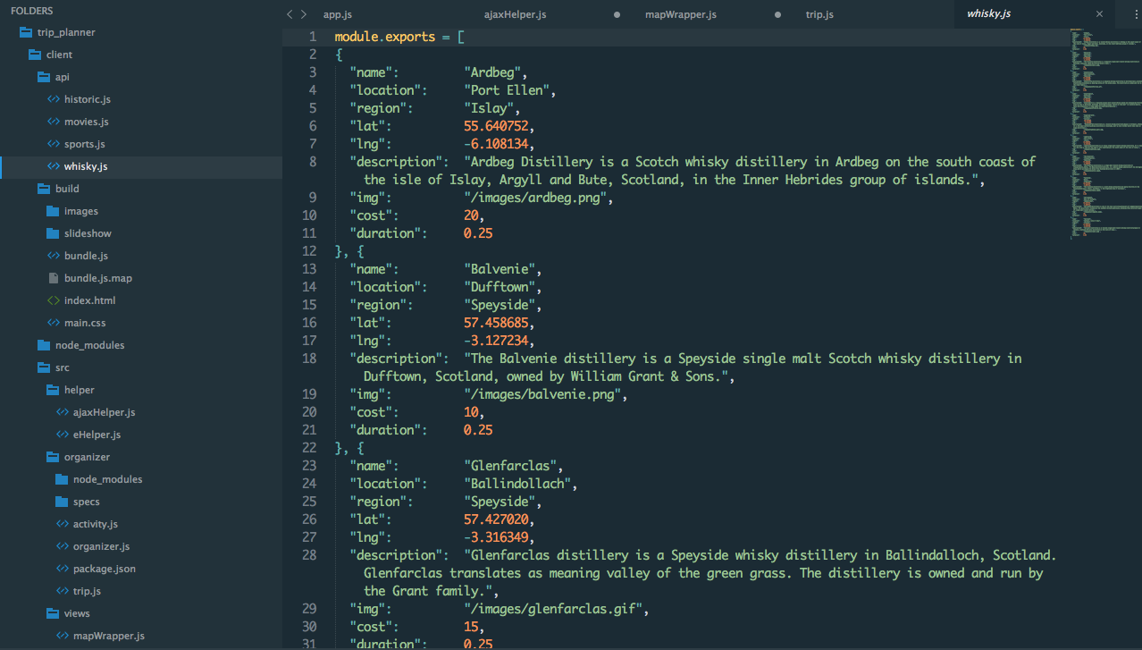
Created our own API’s

Slide 25
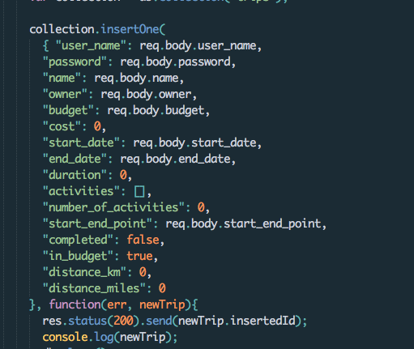
Server.JS
This is the basic information that we had.
We needed to retrieve the ID so that we could carry it to the second page and then insert the activities in the right object

Slide 26
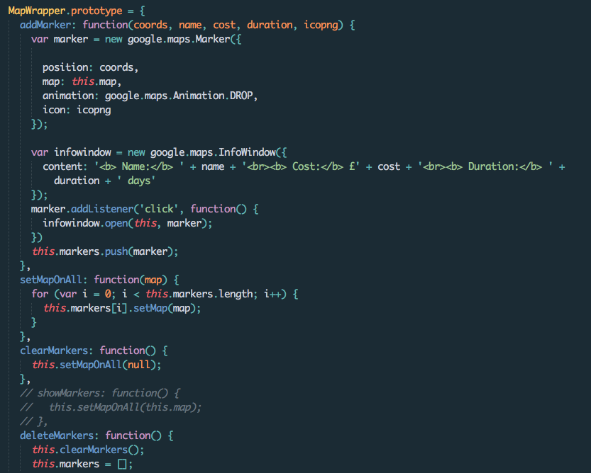
MapWrapper.js

Slide 27
LESSONS LEARNT
GOOD
Worked Well as Team
Tom is the face and the man at CSS
Enjoyed working together
BAD
Databases bite ass
Ensure all Terminal Processes are running!
Avoid Cyrus Virus

Slide 28
Future Enhancements...
Refactor App.js
Add more data to the ScotTrip API’s
Add Authenticated login
Add accommodation and places to eat
Buy the www.ScotTrip.com URL and start making money...

Slide 29
Thank you...
ANY QUESTIONS?
But Not from MatThew…(or RYAN)

